Slide 1
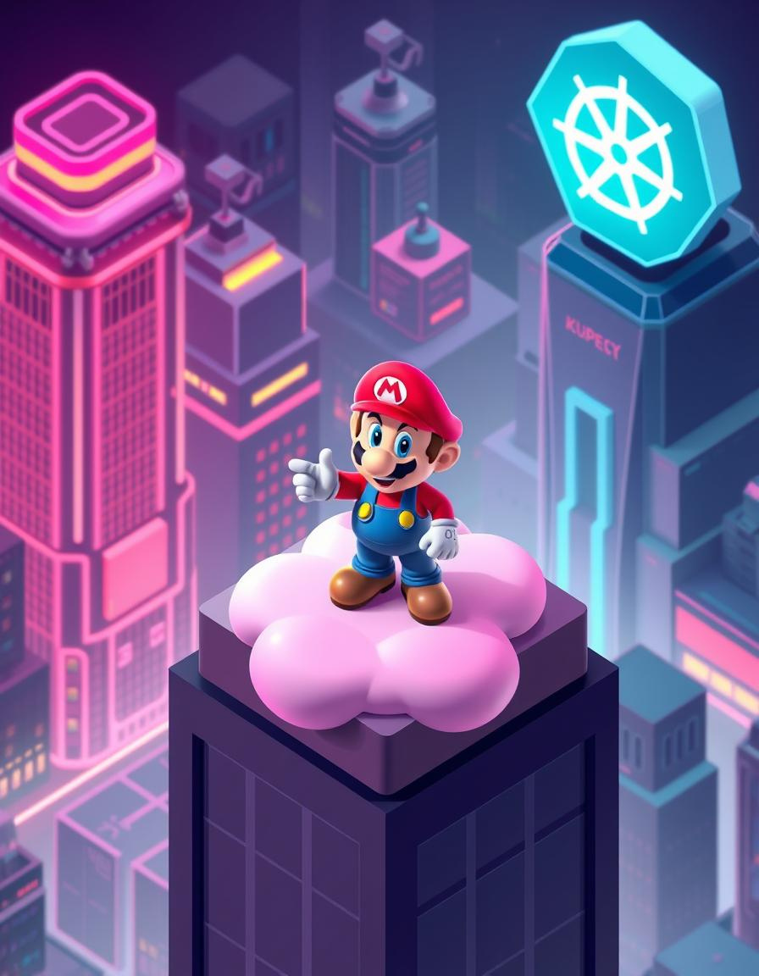
Deployment of Super Mario on Kubernetes using Terraform

Slide 2
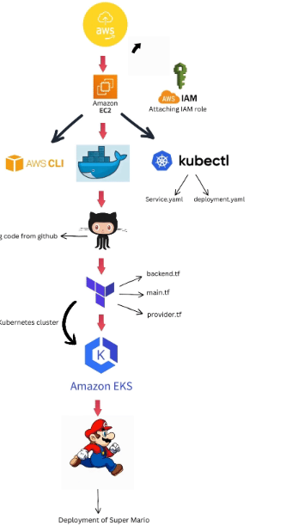
Super Mario Architect

Slide 3
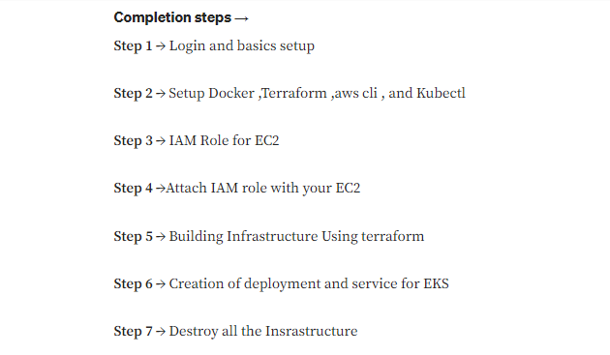
Steps

Slide 4
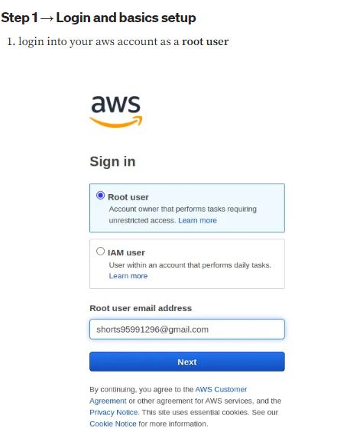
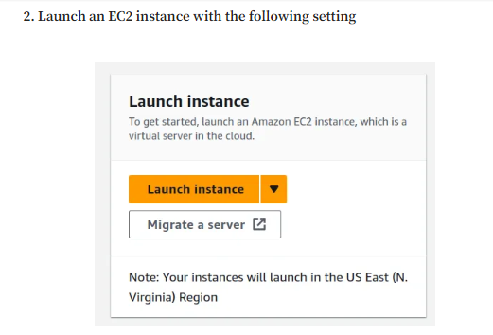
Login with Root Credentials
Launch Instance

Slide 5
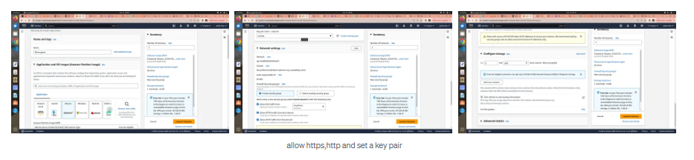
EC2 Instance Creation

Slide 6
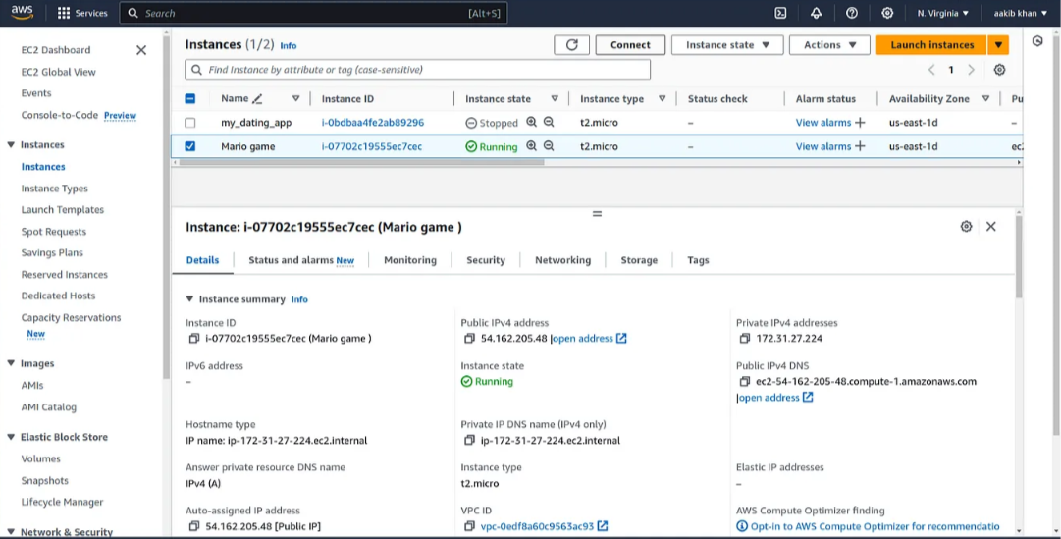
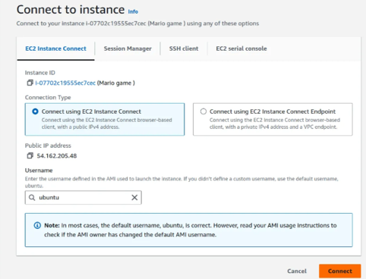
Launch Instance
Connect to Instance

Slide 7
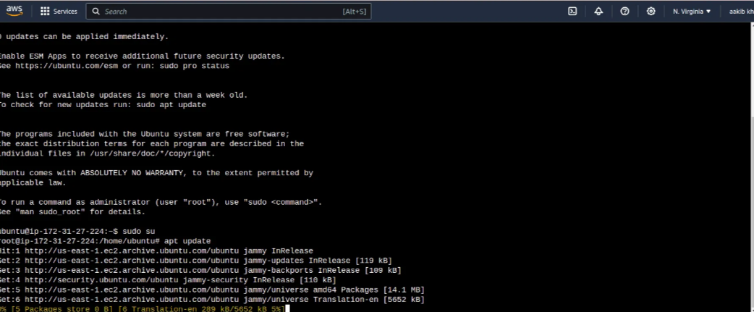
5. run the following commands
a. sudo su
b. apt update -y

Slide 8
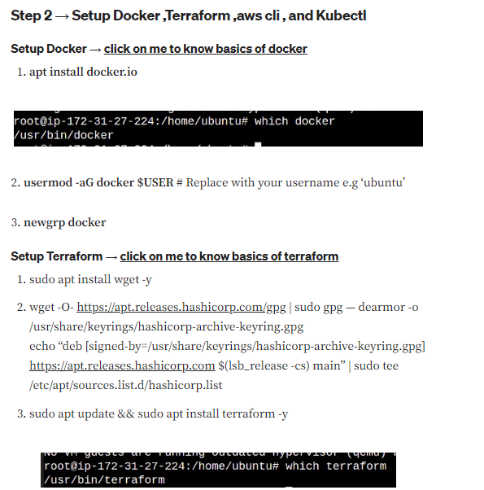
Setup Docker && Terraform

Slide 9
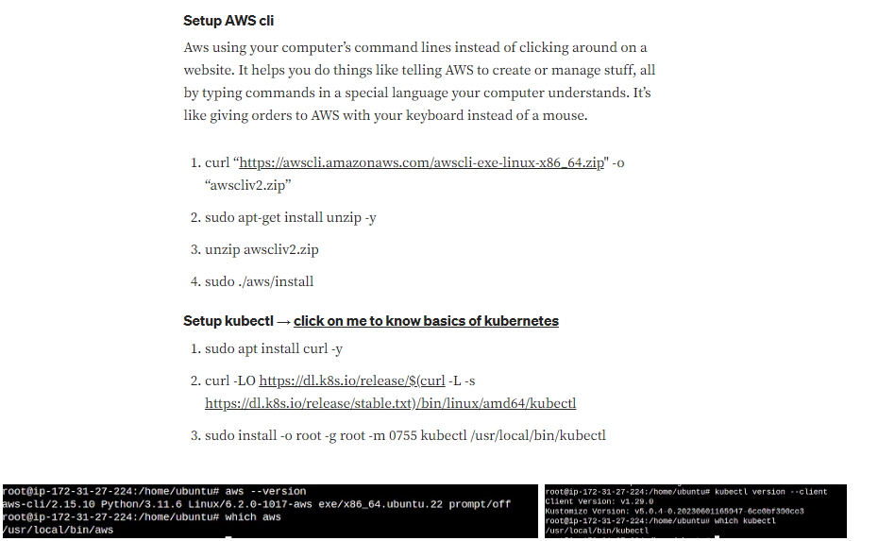
Setup AWC CLI && Kubectl

Slide 10
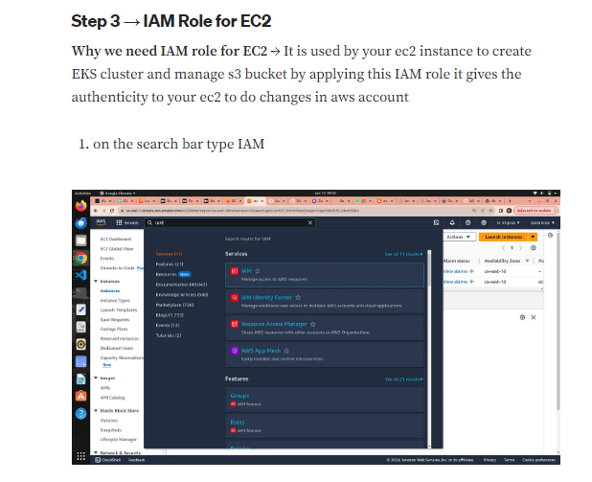
IAM Role

Slide 11
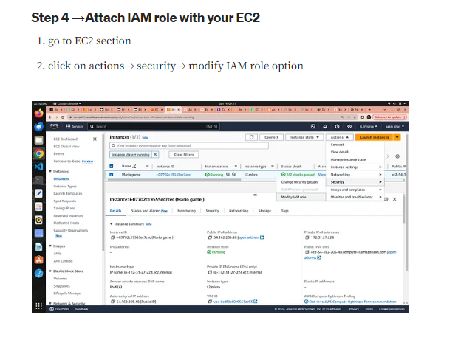
Attach IAM role to EC2

Slide 12
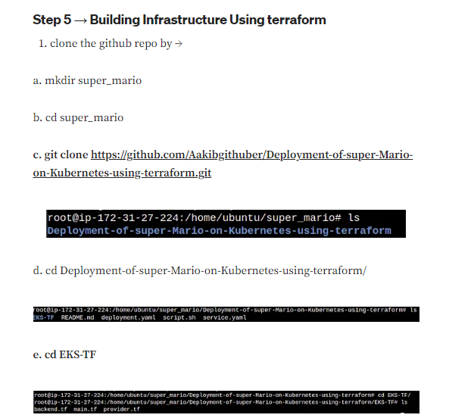
Infrastructure Using Terraform

Slide 13
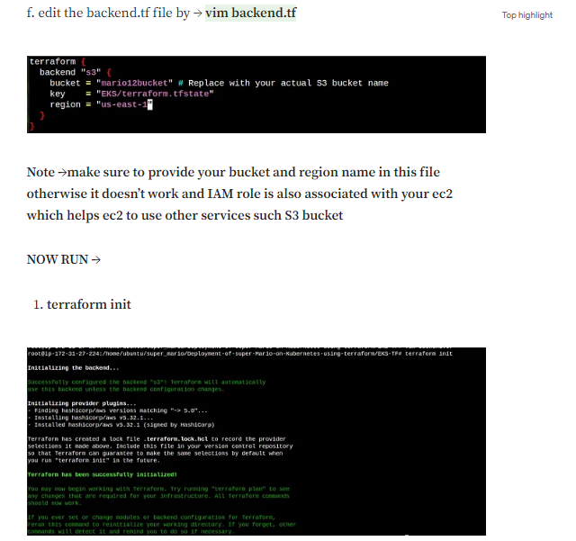
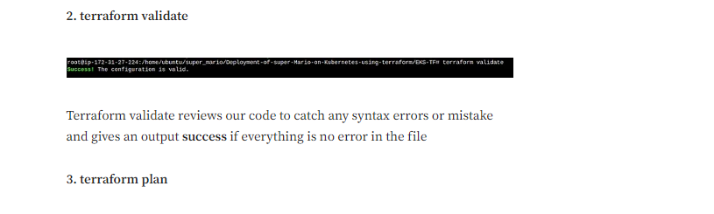
Edit S3 Bucket Name
Then Run Terraform init
Terraform validate && Terraform Plan

Slide 14
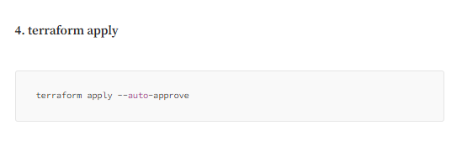
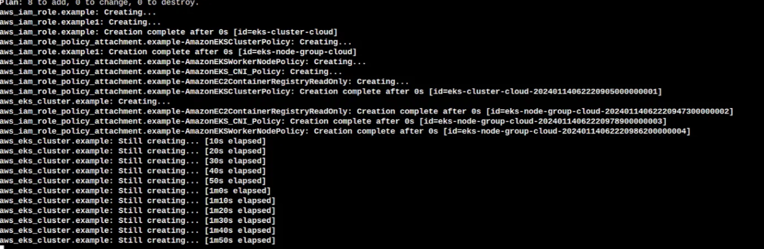
Run Terraform Apply

Slide 15
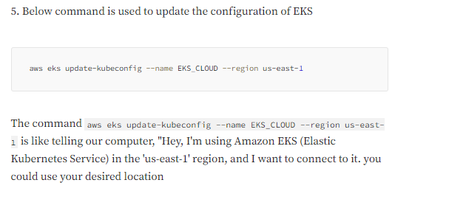
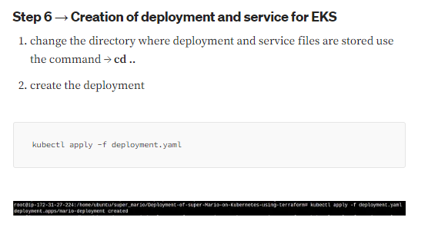
EKS Configuration
Deployment on EKS

Slide 16
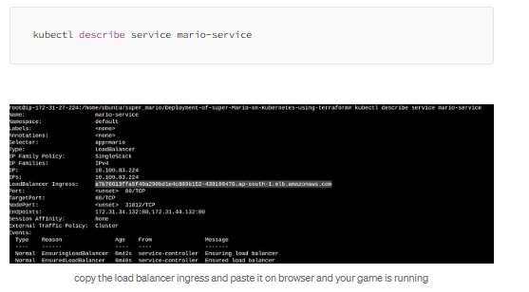
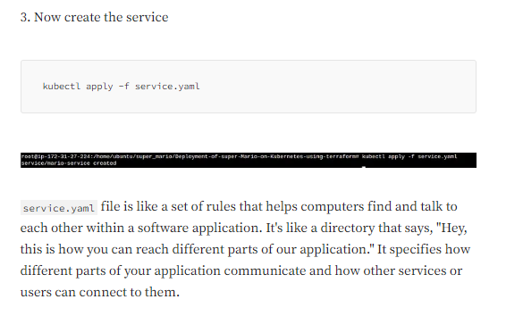
Create Service
Get Load Balancer ingress

Slide 17
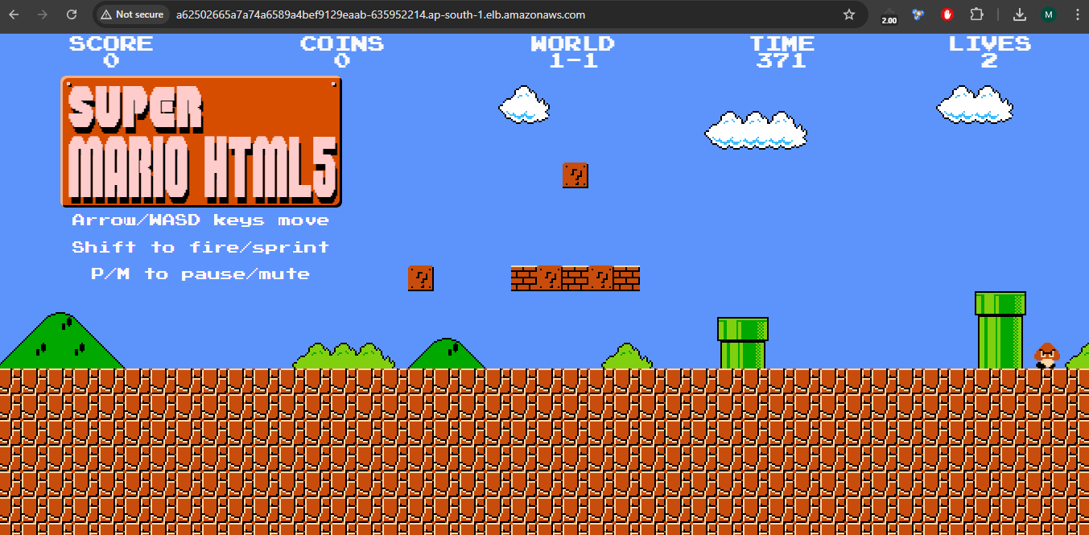
Launch The Game

